Slide 1
Teaching F# From numerical expressions to 3D graphics
Tomáš Petříček
F# enthusiast and F# book author
PhD student at University of Cambridge

Slide 2
Target audience
Freshman students
Basic knowledge of math principles (Not too much – they may not like it)
Earlier in high-school or later at university should be fine too
Possibly first programming course
Controversial topic, but F# has many benefits

Slide 3
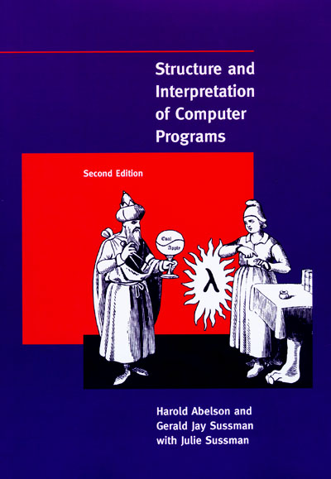
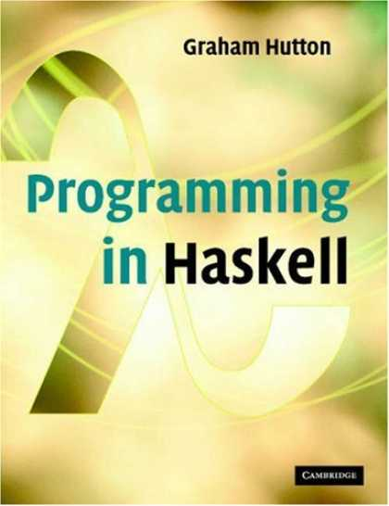
Related functional textbooks #1
Emphasize theory and abstract thinking

Slide 4
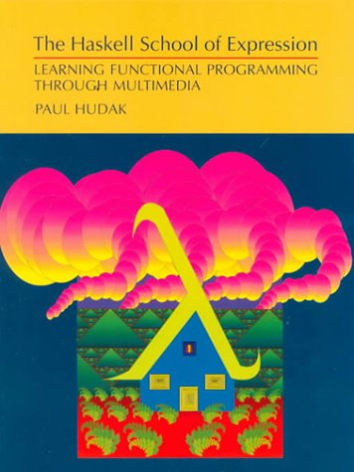
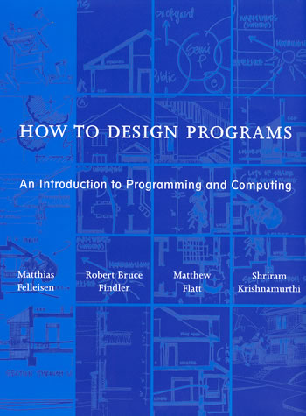
Related functional textbooks #2
Functional programming with fun demos

Slide 5
Why F# as a first language?
Mathematically oriented language
Supplements math and theory courses
Eliminates differences between students
Open-source with cross-platform support
F# for MonoDevelop on Linux/Mac
Practical language with some market
.NET/Mono skills are valued by industry
Very easy transition to C# and other languages

Slide 6
Expressions in F#
First functional programming steps

Slide 7
What F# shares with math?
Language is exact – we need to precisely say what we want to get
Composition does not break things – we can mix various correct facts
Things do not change – theorems will always be true, π will not change

Slide 8
Pythagorean theorem
Math has equations and expressions
Expressions can be evaluated
Using F# Interactive
> sqrt((pown 3.0 2) + (pown 4.0 2));;
val it : float = 5.0

Slide 9
Introducing let declarations and if
Solving quadratic equations
Script for solving written in F#
let d = pown b 2 - 4.0 * a * c;;
if d < 0.0 then "No real solution"
elif d > 0.0 then "Two solutions"
else "One solution";;
let x1 = (-b + sqrt d) / 2.0 * a
let x2 = (-b - sqrt d) / 2.0 * a;;

Slide 10
DEMO
Working with F# expressions

Slide 11
Composing graphics in F#
Fun examples for students to play with

Slide 12
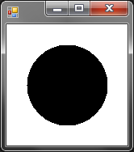
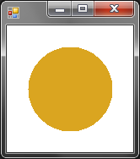
Composing graphics
Expressions that have drawing as the result
Same concepts as mathematical expressions
Basic shapes
Functions for creating new shapes
> Fun.circle 100.0f;;
val it : Drawing = (Drawing 100x100)
> Fun.fillColor Color.Goldenrod
(Fun.circle 100.0f);;
val it : Drawing = (Drawing 100x100)

Slide 13
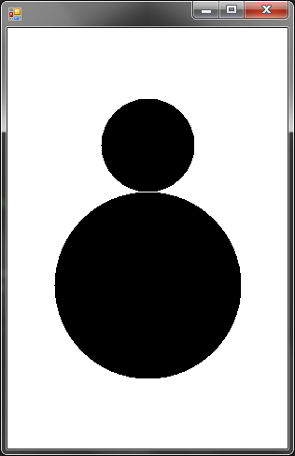

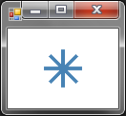

Working with shapes
Composing drawings using custom operator ($)
Let declarations to reuse drawings
Fun.circle 200.0f $
Fun.move 0.0f 150.0f (Fun.circle 100.0f)
let plus =
Fun.lineStyle 2.0f Color.SteelBlue
( Fun.line -10.0f 0.0f 10.0f 0.0f $
Fun.line 0.0f -10.0f 0.0f 10.0f )
let star = plus $ (Fun.rotate 45.0f plus)
let bigStar = Fun.scale 2.0f 2.0f star

Slide 14
DEMO
Creating drawings using F# expressions

Slide 15
Introducing recursion and 3D
Difficult concepts explained using graphics

Slide 16
Explaining recursion
Recursion is tricky concept
Two types of recursions (from HTDP)
Structural – follows recursive data structure
For example lists, trees, expressions etc.
Such functions must terminate in F#
General – arbitrary recursive calls
May not terminate (if it is not well written)
For example generating fractals

Slide 17
General recursion for lists
Not tail-recursive list length
Easy visualization of execution
Not tail-recursive – work done on the “way back”
let rec length list =
match list with
| [] -> 0
| head::tail -> (length tail) + 1

Slide 18
General recursion for lists
Tail-recursive list length
All work done on the way “forward”
This is what tail-recursive means!
let rec length acc list =
match list with
| head::tail ->
let newacc = acc + 1 in length newacc tail
| [] -> acc;;

Slide 19
DEMO
Generating drawings from lists

Slide 20
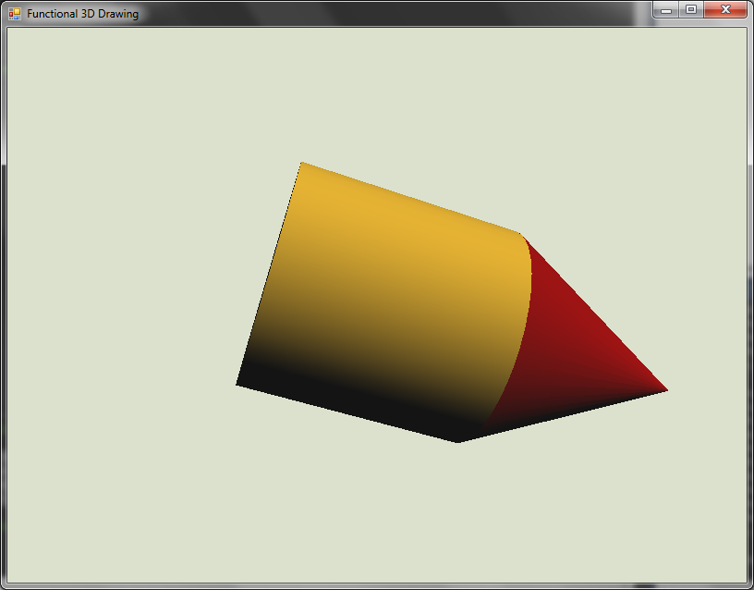
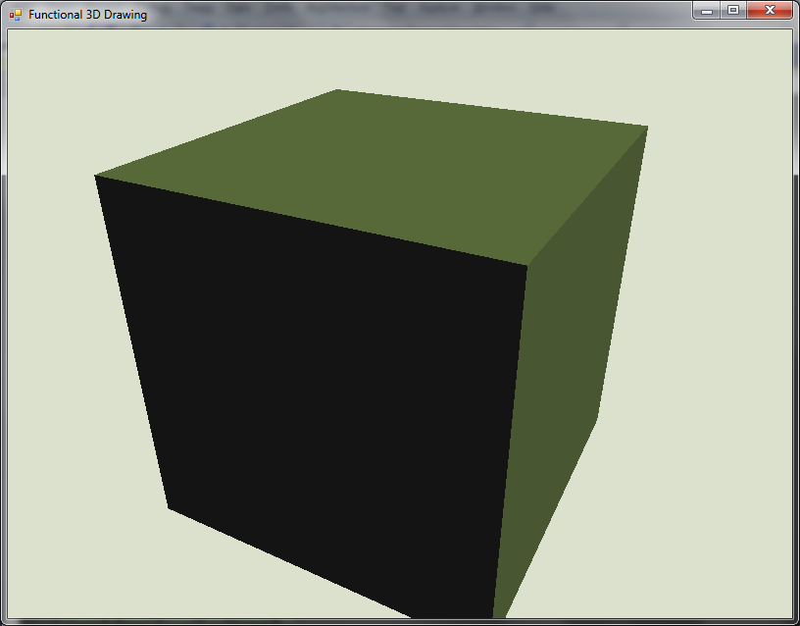
Adding new dimension to drawings
Expressions that define 3D objects
Just like math and 2D graphics
Fun.color Color.DarkRed Fun.cone $
( Fun.color Color.Goldenrod
(Fun.translate (0.0, 0.0, 1.0)
Fun.cylinder) );;
val it : Drawing3D = (...)
> Fun.cube;;
val it : Drawing3D = (...)

Slide 21
DEMO
Introducing general recursion using 3D objects

Slide 22
Links and Q & A
Functional variations Web Site
Cross-platform F# support Teaching materials for F#, etc…
http://functional-variations.net
If you’re interested in more, get in touch!
http://tomasp.net | tomas@tomasp.net
http://twitter.com/tomaspetricek

